Slide 1
Unitedworld Invoice Management System

Slide 2
The invoice link and login details
Link: - https://invoice.unitedworld.in/
You can log in with your email id (mentioned on KEKA (HRMS portal)).

Slide 3
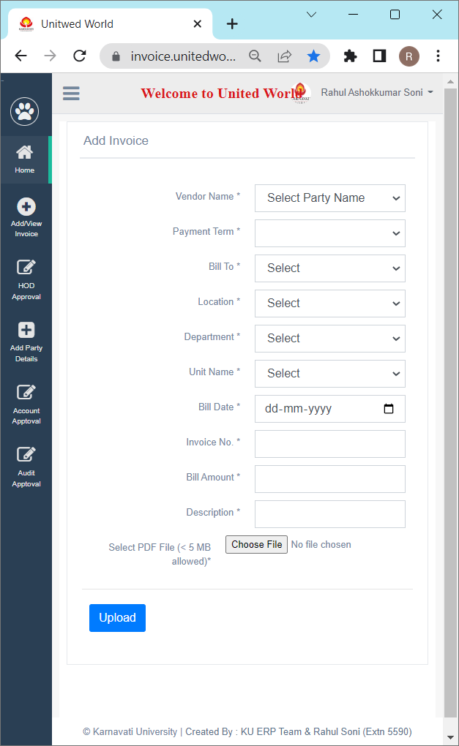
Add general invoice
Click on Add/View Invoice >> Add Invoice.
Party Name: - Select the same from the Dropdown (if the Party name is not visible in the list following the process of Add Party name).
Payment Team: - No Need to Select.
Bill to: - Select as per dropdown.
Location: - As per the Location.
Department: - Select as per Invoice.
Unit: - Select College Name.
Bill Date: - Bill Date as per Invoice.
Invoice Number: - As per the Invoice.
Bill Amount: - As per the Invoice.
Description: - Invoice Description.
Select File: - Only PDF file is allowed.

Slide 4
Add Advance/Performa invoice
Click on the dropdown menu >> Add/View Bill >> Request for advance/ Performa invoice
Party Name: - Select the same from Dropdown (if the Party name is not visible in the list following the process of Add Party name)
Bill to: - Select KMET.
Location: - As per the Location.
Department: - Select as per Invoice.
Unit: - Select College Name.
Tour Reference No.: - The same is applicable in tour advance only and the same is decided by your approval authority else mention “NA”
Tour start date: - It should be mentioned as per your travel start date and for the Performa, you can mention the Performa invoice date.
Tour End date: - It should be mentioned as per your travel end date and for the Performa, you can mention the Performa invoice date.
Description: - Advance/Performa Invoice Description.
Select File: - Only PDF file is allowed if applicable.
You need to submit the final invoice/advance details to the portal once the tour is completed / the final invoice is received from the party the same is reflected as per below.
Click on the dropdown menu >> Add/View Bill >>Pending invoice – Advance Req/ Performa Invoice.

Slide 5
Add party name/details
Click on the dropdown menu >> Party Master >> Add/Edit Party >> click on Add button
Party Name: - Party Name as per Invoice
Payment Term: - Min Payment Term is 5 days you have to mention more than days
Party GST No.: - GST number of Party if available else mention as “NA”.
Income Tax/Pan No. : - Pan card Number of Party.
MSME Registration No. : - MSME number of Party if available else mention as “NA”.
Party Name & Contact No. : - contact person name and contact details of the Party
Party Address: - Communication address of Party.

Slide 6
Thank you !!
If you have any queries or issues you can reach me on my mobile/extension or write a mail to me.
Name: - Rahul Soni
Mobile No.: - +91 99780 05717
Extension: - 5590
Email ID:- accit@karnavatiuniversity.edu.in

